Slide 1
Docker Orchestration

Slide 2
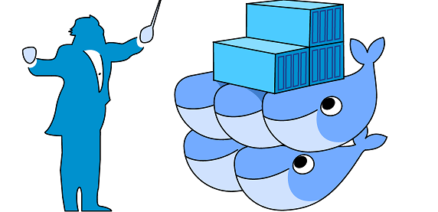
Docker Orchestration
Orchestration: Tools to manage, scale, and maintain containerized applications are called orchestrators, and the most common examples of these are Kubernetes, Docker Swarm, AWS ECS, AWS EKS etc.
Orchestration allows us to manage and maintain multiple containers. This is especially helpful in software development where we maybe making use of micro-services architecture as it breaks down the software into small manageable chunks. Having different configurations and environment becomes easier with orchestration.

Slide 3
Benefits of Docker Orchestration
Easy Deployment.
Easy management.
Easy resource management.
Allow for heath monitoring of the containers.
Load balancing among different containers.
Easy updating.
Easy scaling up and rolling back.
Creates layer of security.

Slide 4
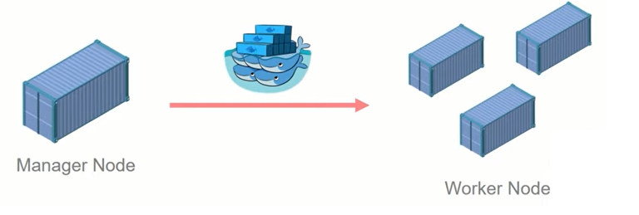
Docker Swarm
Docker Swarm is an orchestration management tool that runs on Docker applications. It helps end-users in creating and deploying a cluster of Docker nodes.
Each node of a Docker Swarm is a Docker daemon, and all Docker daemons interact using the Docker API. Each container within the Swarm can be deployed and accessed by nodes of the same cluster.

Slide 5
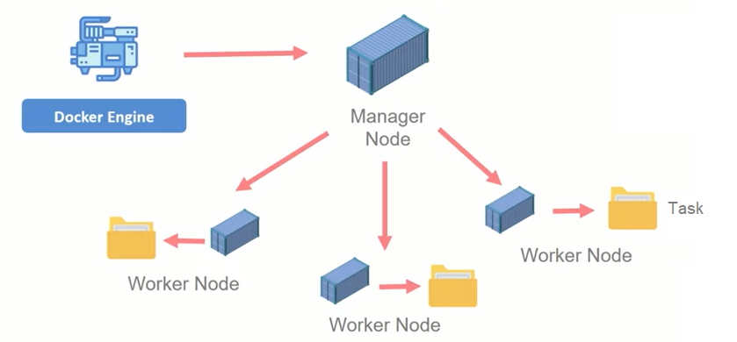
Docker Swarm Architecture

Slide 6
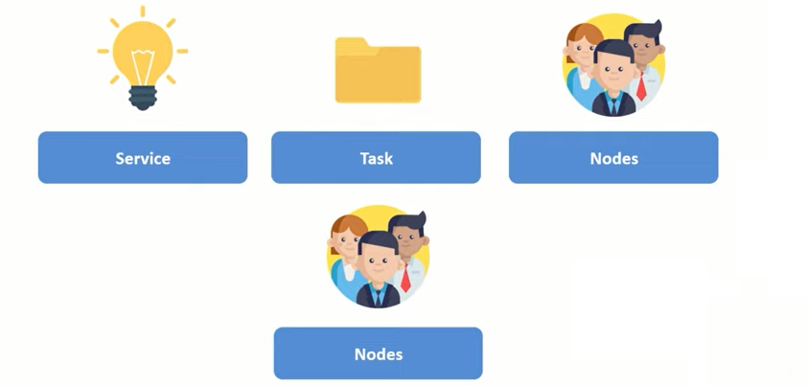
Docker Swarm Components

Slide 7
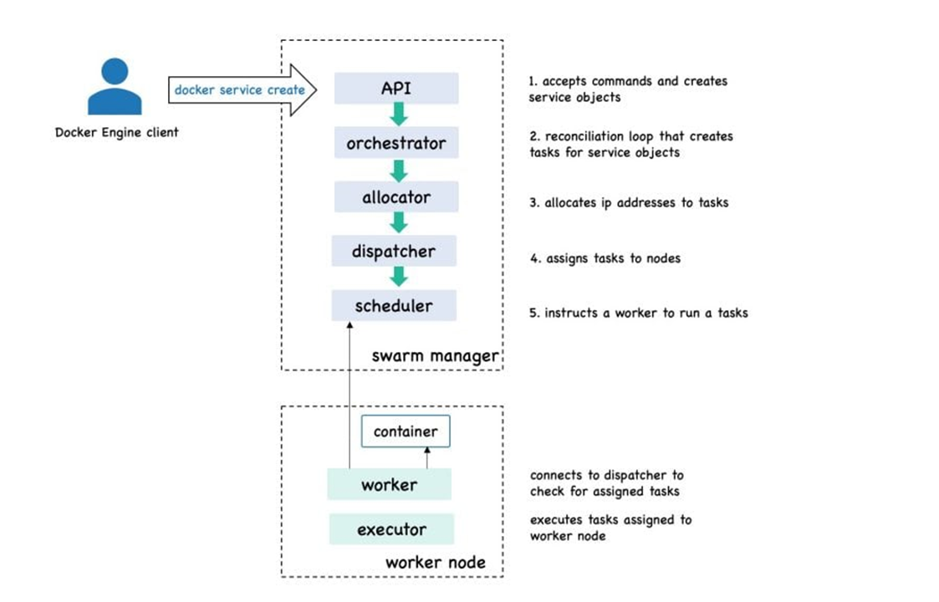

Slide 8
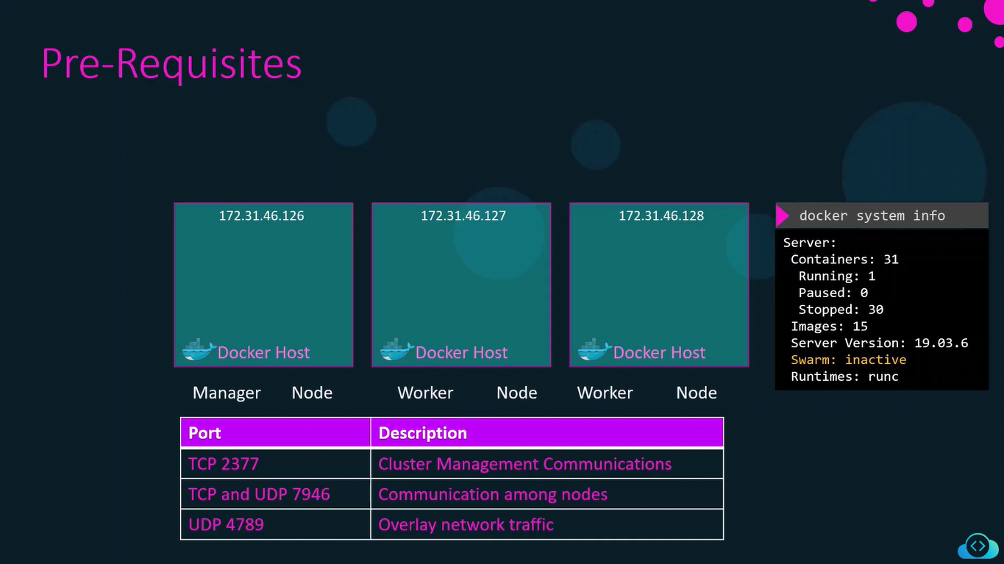

Slide 9
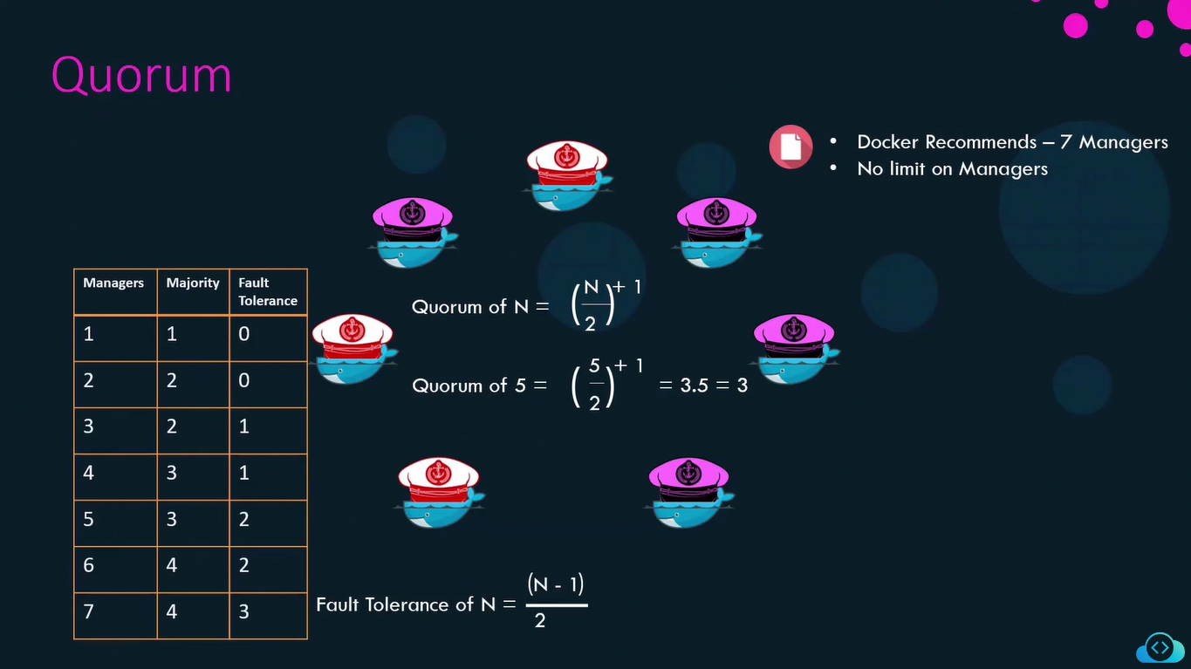

Slide 10
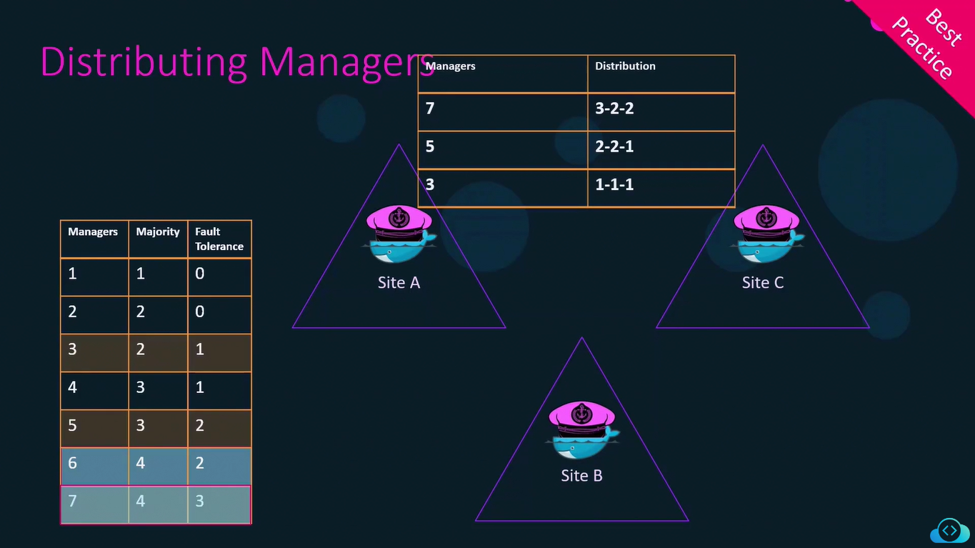

Slide 11
Docker Swarm Commands
Commands to work with Docker Swarm:
~ sudo docker swarm init –advertise-addr <manager_node_ip>
~ docker swarm join –-token <token>
~ sudo docker node ls
~ sudo docker info
~ sudo docker swarm leave
~ sudo docker swarm join-token worker
~ sudo docker swarm join-token manager
~ sudo docker node rm <node_id>
~ sudo docker swarm leave –-force (stop swarm or leave manager)
~ sudo docker service create --name fun –-replicas 3 –p 80:8080 httpd
~ sudo docker service ls

Slide 12
Docker Swarm Commands
Commands to work with Docker Swarm:
~ sudo docker service ps fun
~ sudo docker rm –f <service_container_name>
~ sudo docker service inspect fun
~ sudo docker service rm fun

Slide 13
Docker Stack
A stack is a group of interrelated services that share dependencies and can be orchestrated and scaled together.
We can make use of docker compose here to run multiple services.
Commands to work with Docker Stack:
~ sudo docker stack deploy –c docker-compose.yml <stack_name>
~ sudo docker service scale <service_name>=3
~ sudo docker stack services <stack_name> (To see stack specific services)
~ sudo docker node update –-availability drain <node_id>
~ sudo docker node update –-availability active <node_id>
~ sudo docker service update –-image mysql:latest <service_id>
~ sudo docker stack rm <stack_name>

Slide 14
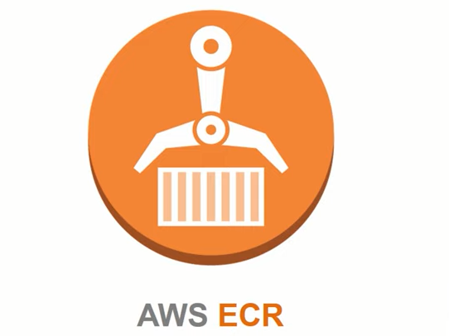
AWS ECR
Amazon Elastic Container Registry (ECR) is a fully managed Docker container registry that makes it easy to store, share, and deploy container images. Once docker client has been authorised it can push and pull to and from the ECR.
It is useful in a scenario when you don’t want to manage dedicated storage for images and want to use other AWS services that make use of it.

Slide 15
AWS ECR Commands
Commands to work with AWS ECR:
Login
~ sudo aws ecr get-login-password --region ap-south-1 | docker login --username AWS –
password-stdin 658256467033.dkr.ecr.ap-south-1.amazonaws.com
2. Build your docker image.
~ docker build -t study .
3. Tag your docker image
~ docker tag study:latest 658256467033.dkr.ecr.ap-south-1.amazonaws.com/study:latest
4. Push image in AWS ECR.
~ sudo docker push 658256467033.dkr.ecr.ap-south-1.amazonaws.com/study:latest

Slide 16
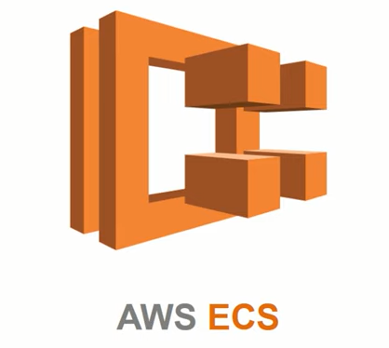
AWS ECS
Amazon Elastic Container Service (ECS) is an AWS service that allows us to orchestrate our software deployment. It acts like any other orchestration tool like Kubernetes or Docker Swarm. It allows us to deploy, update, rollback, scale up our software development.

Slide 17
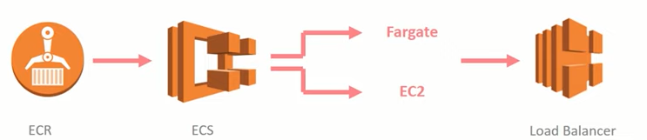
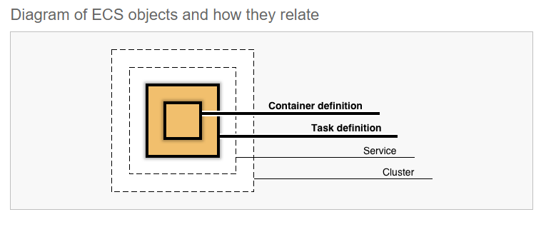
AWS ECS

Slide 18
Thank You !

